Slide 1
IMS - Project
Syed Zaidi

Slide 2
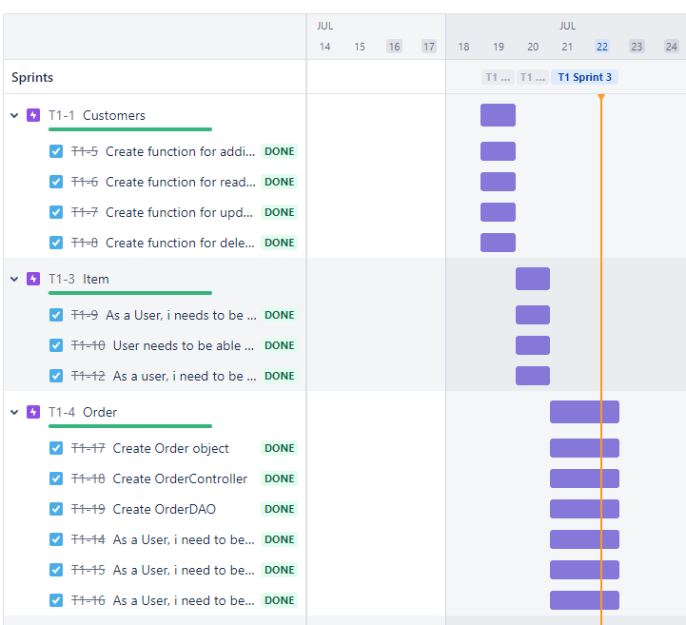
Jirra – Kanban Board
Created Project in Jirra
Enabled Kanban board with sprint and backlog functionality
Created epics and user stories from end user perspective
Assigned epics as parents

Slide 3
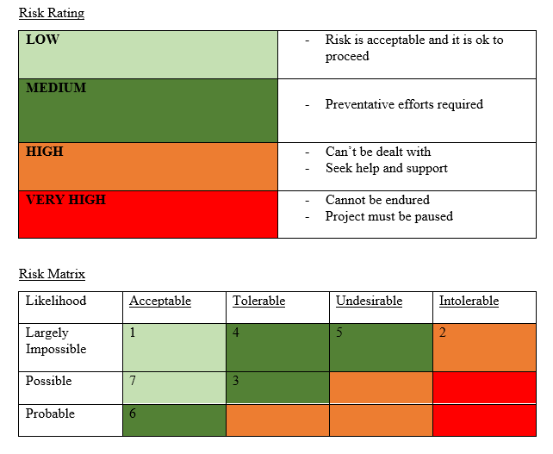
Risk Assessment
Identified risks
Power cut.
Corrupted hard drive.
Excessive weather.
Laptop battery dying.
Local repository folder erasure.
Procrastination and or life problems.
Software Crashing
Github Server Crash

Slide 4
Risk Assessment Cont
Responses to risk
Combination of laptop battery, and mobile data connection can ensure work continues.
Have hard drive looked at by a computer repair shop to see if corrupted files can be recovered. Save work regularly.
Take regular breaks to ensure productivity remains consistent and optimum
Save work regularly, such that in said event potential loss of work is minimal or non-existent
Save and push work regularly, don’t let work that hasn’t been pushed pile up.
Plan time accordingly with regular breaks, and deal with life problems as they arise to minimise effect on work
If software crash occurs, then try not to excessively interact with PC. Patiently wait for it to respond and continue with work.
Github servers are unlikely to crash, however if they do then simply wait for them to return online.
Risk Mitigation
If power cut occurs, then I’ll ensure I keep my laptop battery fully charged to endure the outage.
To prevent the risk of hard drive corruption, I’ll ensure to save and push my work regularly. Allowing my laptop to fully power down regularly should be beneficial as well.
In the event of extreme weather where there is a risk to health, then regular breaks should be taken.
Ensure to keep laptop fully charged, or on charge as often as possible.
In the event of local repository erasure, to minimise risk of loss of work, files should be saved and pushed regularly.
If life problems do occur (which they will) then they should be dealt with asap. Procrastination can be minimised using effective time management and planning.
The potential effects of software not responding can be minimised by regularly saving work, and or pushing to remote repo.
If in event of server crash, push and pull work to maintain file congruence between repo and local folders.

Slide 5
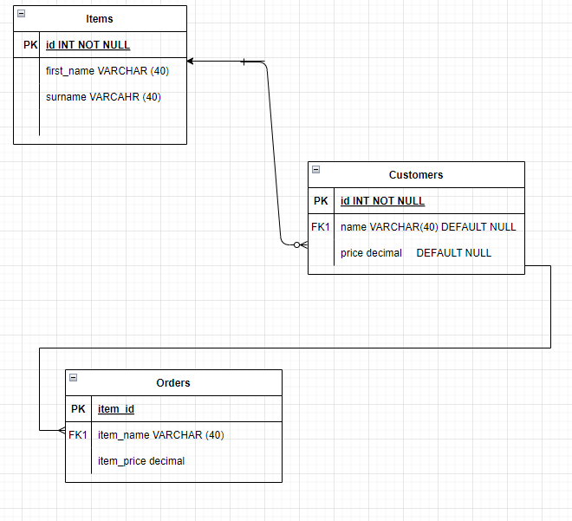
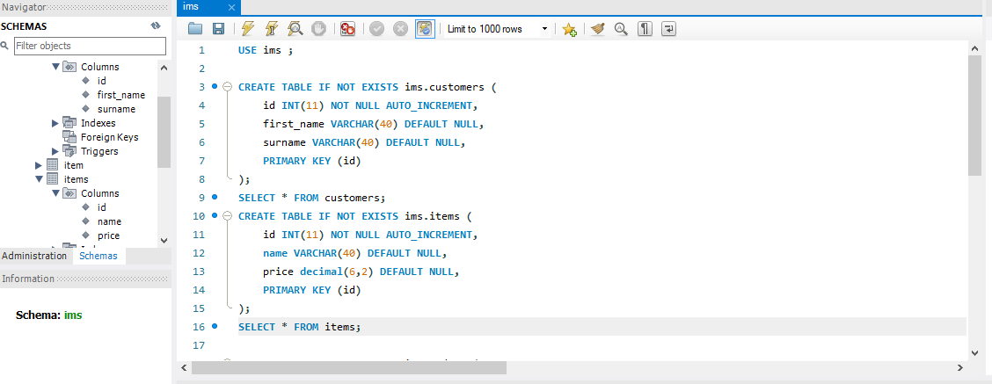
SQL – Entity relationship diagram
Table Creation –
Customers, Items, Orders
Setting up SQL connection with eclipse
Packages not loading in properly
leaving runner unable to run
Smart import – HTTPS

Slide 6
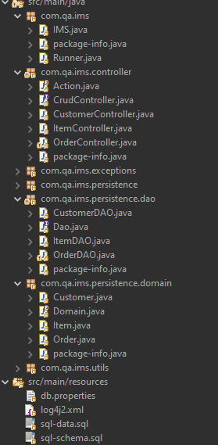
Development - Class Creation
Item Object
Item DAO
Item Controller
Order Object
Order DAO
Order Controller
The relationship between the Object, DAO, and Controller classes are what underpins the CRUD functionality.
Writing and developing these classes is at its core the function of the application.

Slide 7
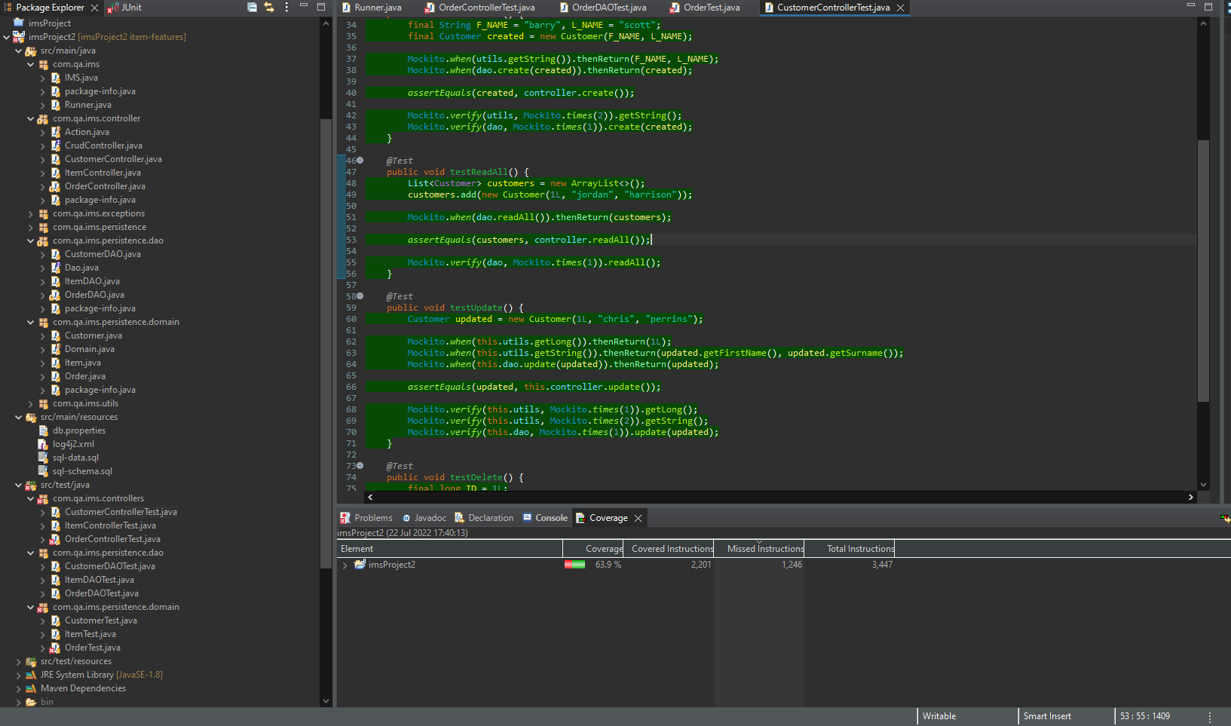

Testing
Testing using Junit and Mockito

